Slide 1

Digital Hearing Aid
By:
Fraol Bereket
Henok Hailu

Slide 2
Topics
Introduction
Literature Review
Theoretical Background
Methodology
Software Implementation
Result

Slide 3
Introduction
The ear is one of the most vital organ of our body.
Currently more than 1.5 billion people (nearly 20% of the global population) live with hearing loss.
A hearing aid is an electronic device used to improve hearing by amplifying sound to a person with hearing loss.
It receives sound through a microphone, amplifies it, changes it into digital signal, processes this digital signal, and finally converts the signal back to analogy sound.

Slide 4
Problem Statement
The World Health Organization’s (WHO) survey report shows that around 20% of the global population suffers from hearing problem.
And in less than 30 years, nearly 2.5 billion people globally face a hearing loss problem.
Significant number of people with hearing loss live in low- and middle-income countries.

Slide 5
Objective
General Objective
Develop a system that takes any analog sound as an input and it processes the input and gives clear sound using a digital sound processing
Specific Objective
Implement our system to a wearable device that assists hearing disorder people
Digital Hearing Aid with a reasonable price and less power consumption..

Slide 6
Literature Review
Hearing aids are devices used by hearing impaired people to compensate hearing losses.
Types of hearing loss
conductive : caused by any obstruction that prevents sound waves from reaching the inner ear.
Sensor Neural : hearing loss refers to problems in the cochlea or the auditory nerve.

Slide 7
Literature Review
Hearing aids differ by:
Design
Technology used to achieve amplification (i.e., analog vs digital)
Special features

Slide 8
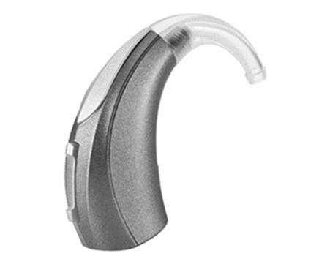
Types of Hearing Aid
Body Worn : It has 2 basic components: an Ear-mold and a case.
Behind the Ear Hearing Aids (BTE) : sits behind the ear.
Suitable for people with low-frequency hearing loss
Reduces the occurrence of feedback loops
Comfortable fit and design
May cause earwax build-up

Slide 9
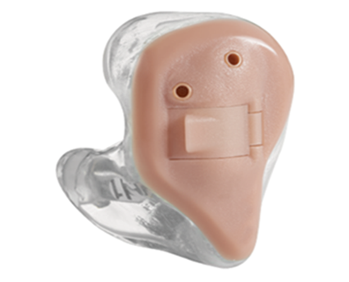
Types of Hearing Aid
In the Ear Hearing Aids (ITE)
The entire hearing aid is housed in a hard plastic case and fitted on the outer ear.
Can use directional microphones
It can feel like it’s blocking your ear

Slide 10
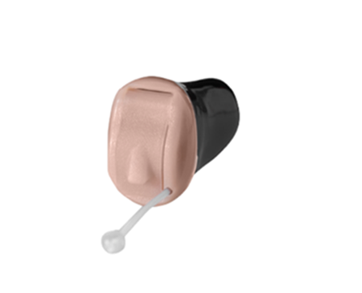
Types of Hearing Aid
In the Canal (ITC)
suitable for treating mild to moderate hearing loss and often come with directional microphones to improve sound clarity and quality.
Less noticeable
Discreet and relatively unnoticeable
Aren’t suitable for profound hearing loss
Can cause wax or moisture build-up

Slide 11
Analog and Digital hearing aids
Analog hearing aids
These hearing aids essentially amplify all sounds (e.g., speech and noise) in the same way.
Digital hearing aids
have all the features of analog programmable aids, but they convert sound waves into digital signals and produce an exact duplication of sound.

Slide 12
Theoretical Background
The audible frequency range for human ears is 20 Hz to 20 kHz.
Sensitive in the range of 1 kHz to 4 kHz.
Audiogram
Hearing loss is measured in decibels hearing level (dB).
If person can hear sounds across a range of frequencies at -10 dB to 26dB it a will considered as having normal hearing.

Slide 13
Fast Fourier transform (FFT)
An algorithm that computes the discrete Fourier transform (DFT) of a sequence, or its inverse (IDFT).
It converts a signal into individual spectral components and thereby provides frequency information about the signal.
Sampling frequency fs ,Block length BL
Bandwidth fn (Nyquist frequency) = fs / 2
Measurement duration D= BL / fs
Frequency resolution df= fs / BL

Slide 14
Methodology
Working principle of our design
Microphones
Amplifiers
Filter
ADC
Microcontroller
DAC

Slide 15
Methodology…
Digital hearing aids have all the features of analog programmable aids. They convert sound waves into digital signals and produce an exact duplication of sound.
The digital hearing aids allow for more complex processing of sound during the amplification process which may improve their performance in certain situations

Slide 16
Working principle of our design
Acoustic signal is picked up by a microphone then. It is fed to a preliminary amplifier that boosts the signal.
Then this signal is transmitted to ADC and transform the analog signal into a digital signal.
The signal will be filtered by the processor and transferred into DAC, The DAC then converts the digital signal to analog signal and then transmits the signal into the microphone.
Microphone generates a sound signal.

Slide 17
Microphones
sound waves are caused to generate or modulate an electric current usually for the purpose of transmitting or recording sound.
Amplifiers
It is an electronic device that can increase the power of a signal
It is a two-port electronic circuit that uses electric power from a power supply to increase the amplitude of a signal applied to its input terminals, producing a proportionally greater amplitude signal at its output.

Slide 18
Filter
The audio filters are the electronic circuits designed to amplify or attenuate a certain range of frequency components.
This helps eliminate the unwanted noise from the audio signal and improves the tone of the output audio.
Filtering is one of the main features of our project that gives the person that use the device will be able to hear a clear noiseless sound

Slide 19
Analog to Digital Converter
It is an electronic integrated circuit used to convert the analog signals such as voltages to digital or binary form consisting of 1s and 0s.
The main features of ADC are sample rate and bit resolution.
Digital to Analog Converter
It converts a digital input signal into an analog output signal. The digital signal is represented with a binary code, which is a combination of bits 0 and 1.
It can reconstruct sampled data into an analog signal with precision. The digital data may be produced from a microprocessor, the data requires the conversion to an analog signal in order to interact with the real world.

Slide 20
Microcontroller
Teensy 4.0 microcontroller specifications are good for digital signal processing.
Teensy 4.0
CPU performance is many times faster than typical 32-bit microcontrollers.
With such a powerful processor it's easy to sample audio and run an FFT in real time
The FPU performs 32-bit float and 64-bit double precision math in hardware
it is relatively cheap and it is designed and made in the USA, guaranteeing a certain level of quality.

Slide 21
Software Implementation
The software implementation of the final project will be on a software called Teensy Duino.
But for now, we used MATLAB, since it has a lot of features.
MATLAB allows matrix manipulations, plotting of functions and data, implementation of algorithms, creation of user interfaces, and interfacing with programs written in other languages.

Slide 22
Software Implementation…
We convert the signal in to a frequency domain because we are going to analyse the audio frequency, basically reduce the noise that is in the signal. After we convert the signal in to frequency domain, we then remove the unwanted frequency.
We analysed the audio signals using FFT, it is an algorithm that computes the discrete Fourier transform (DFT) of a sequence, or its inverse (IDFT).

Slide 23

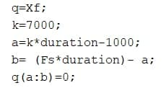
Software Implementation…

Slide 24
Software Implementation…
Fourier analysis converts a signal from its original domain (often time or space) to a representation in the frequency domain and vice versa.
FFT will transform the time domain signal into frequency domain signal. The signal has a real and an imaginary part.

Slide 25
Result
Our work here is to eliminate frequencies that are above some level.
Thanks to the FFT we did it perfectly.
we convert the signal into frequency domain using FFT. Then we take the sample to remove both the imaginary and the real part from the sample. After we do that, we then convert the signal into a time domain using IFFT (inverse FFT).

Slide 26
Remaining Work
Model Implementation.
Hardware implementation.
Increasing the features of our project, like wind suppression and feedback suppression

Slide 27
Thank You

